Slide 1

ACES
ANTI CHEATING ENFORCEMENT system

Slide 2
Overview
Designed to catch cheating based on a Git commit history
Elements
Cpp git committer
Runs each time a student runs unit tests
GitHub Classroom / organization
Forces the use of Git, has multiple advantages
Desktop tool
Built as a C# desktop app
Can be converted to a RESTful API
This is more of a system than 1 specific tool

Slide 3
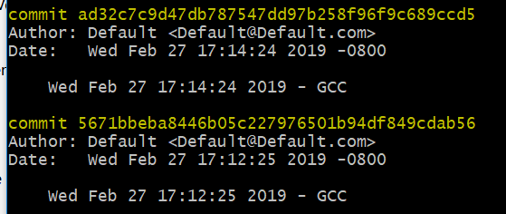
Example Git Log

Slide 4
Challenges
Bringing different interfaces together
Git
GitHub
GitHub Classroom
GitHub Organizations
Not really anything like it out there to research
Deciding on analytics and metrics
Would have built as a web app, but did not have a FERPA server

Slide 5
Next Steps
We are at the prototype stage, still some work to do
Has the potential to become a large automatic grading system with cheating detection
Refine analytics
Move to a web service
Canvas integration
Integration with other anti-cheating tools, such as Moss
Add OS to the Git commit
Stubbed out, just needs to be added

Slide 6
Live Demo
Demo

